Slide 1
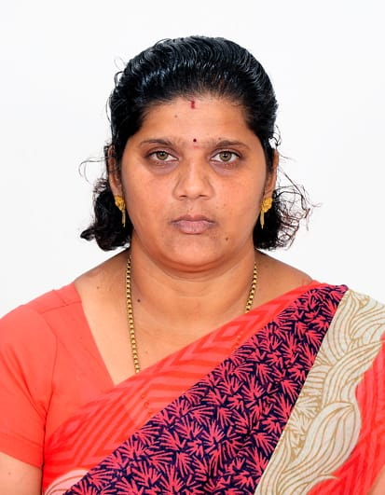
TRINITY COLLEGE FOR WOMEN (Arts & Science) Trinity Nagar ,Mohanur road Namakkal-637002,TamilNadu ,India (Permanent Affiliation Granted by Periyar University, Salem-II) 2f & 12(b) Status Granted by UGC,New Delhi. www.trinitycollegenkl.edu.in
Youth Red Cross Organizes a Programme
“Celebration of Children's Day”
Topic : Our Children are Our Greatest Treasure
Date : 14.11.2022
Time : 03.00 PM
Resource Person : Mrs.S.Hemalatha
Assistant Professor in Tamil
Trinity College for Women, Namakkal
With regards
Mr.P.K.Sengodan, Chairman
Er.K.Nallusamy ,Secretary
Mrs.Aruna Selvaraj ,Director of Executive
Dr.M.R Lakshiminarayanan, Principal
Dr.Arasuparameswaran,Academic Director
Mr.N.S Senthilkumar ,Administrative Officer
Dr. R.Savithri, Programme Officer
Mrs.V.Kalaivani, Adjutant YRC

