Slide 1



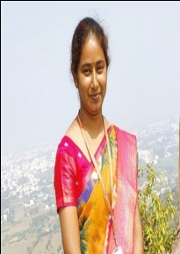
TRINITY COLLEGE FOR WOMEN
(Arts & Science)
Trinity Nagar ,Mohanur road, Namakkal-637002,TamilNadu ,India
(Permanent Affiliation Granted by Periyar University,Salem-II
2f & 12(b) Status Granted by UGC,New Delhi
Accredited by ‘NAAC’ with A+ Grade)
“Observation of World Nature Conservation Day”
Youth Red Cross Conducts a Programme on
Topic : Conserve Paper-Save the Plants
Date : 28.07.2023
Time : 02.00 PM
Resource Person :Mrs.D.Prabha,
Assistant Professor in Computer Science,
Trinity College for Women,
Namakkal
All are Warmly Invited

